Slide 1
IT8303:
AI HUMAN INTERFACE
SNG TIAN HAO, KEITH
1273381F

Slide 2
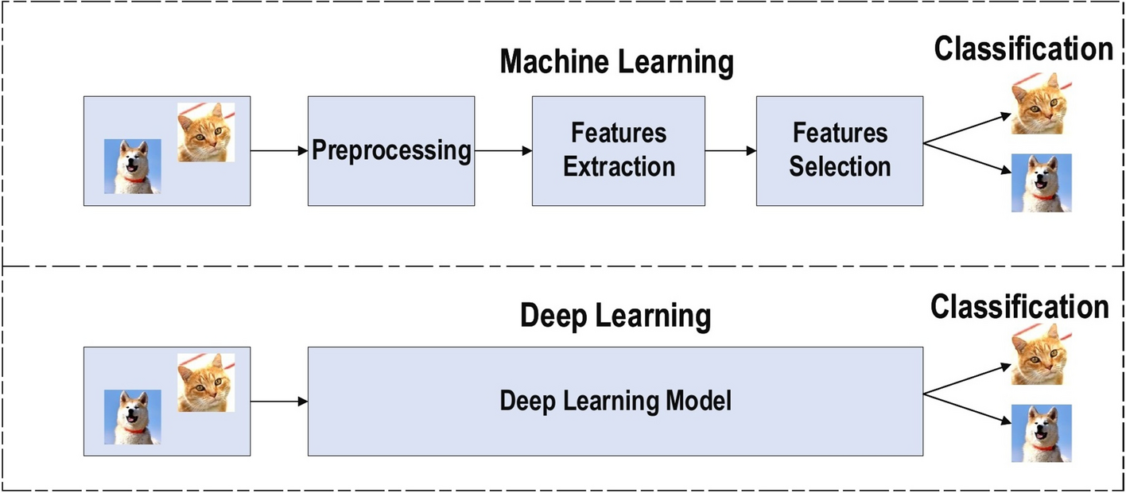
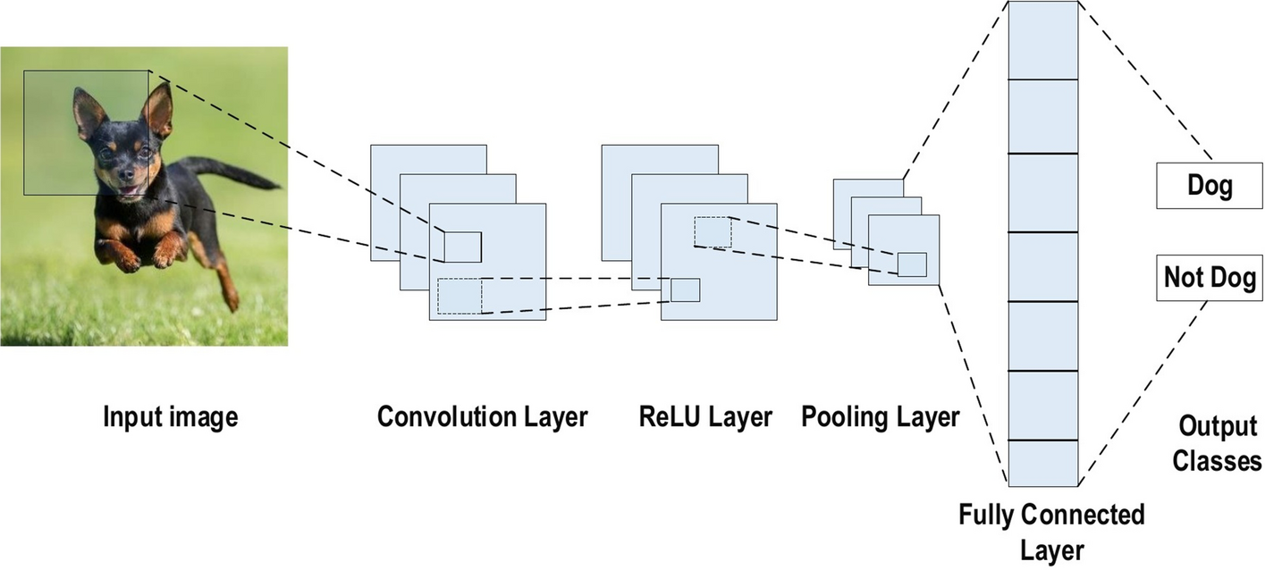
CNN OVERVIEW
CNN a form of deep-supervised learning
Most popular algorithm for computer vision and facial/pattern recognition
Designed to automatically learn spatial hierarchies of features from data
Benefits of CNN:
Translation equivariance: CNNs recognise features regardless of their location in image
Sparse interactions: Interactions limited to receptive field unlike traditional deep-learning models where input features interact with every neuron
Parameter sharing: Usage of the same filter across images reduce the number of trainable parameters and make the model better for generalisation
Alzubaidi, L., Zhang, J., Humaidi, A.J. et al. Review of deep learning: concepts, CNN architectures, challenges, applications, future directions. J Big Data 8, 53 (2021).

Slide 3












Convolutional Layer
Consists of filters (i.e., kernels) with weights
Filter slides over entire image and calculates dot product of the filter and the local image area
Process repeats until sliding not possible
Pooling Layer
Mainly for dimension reduction of feature maps from convolutions
Preserves key information/features
CNN MODEL ARCHITECTURE
Activation Function
Function applied after convolutions to introduce non-linearity
Allows model to learn more complex relationships
Five key components in a CNN model
Fully Connected (FC) Layer
Defined at the end of the CNN model
Each neuron within the FC layer is connected to neurons of the previous layer
FC layer outputs the classification result
Loss Function
Quantifies the model’s predictions in comparison with actual outputs
Loss function serves as feedback for the model which is then used to adjust weights for training
Alzubaidi, L., Zhang, J., Humaidi, A.J. et al. Review of deep learning: concepts, CNN architectures, challenges, applications, future directions. J Big Data 8, 53 (2021).

Slide 4















MODELLING APPROACH
Data Pre-Processing
Simple Baseline
Min-max scaling
Reshape images for CNN input
Split data into: train, validation, and test sets
Create baseline model with a simple model architecture
Baseline serves as foundation for further experimentation
Final Model
Build and train final model based on best hyperparameters
Exploratory Data Analysis
Feature Engineering
Experimentation & Tuning
Model Evaluation
Visual inspection of images
Determine if classes are balanced/imbalanced
Create additional features using data augmenter
Vary image rotation, framing, and zoom level
Iteratively experimented with different model architectures
Tuned candidate model by searching for the best combination of hyperparameters
Evaluate final model against test set

Slide 5
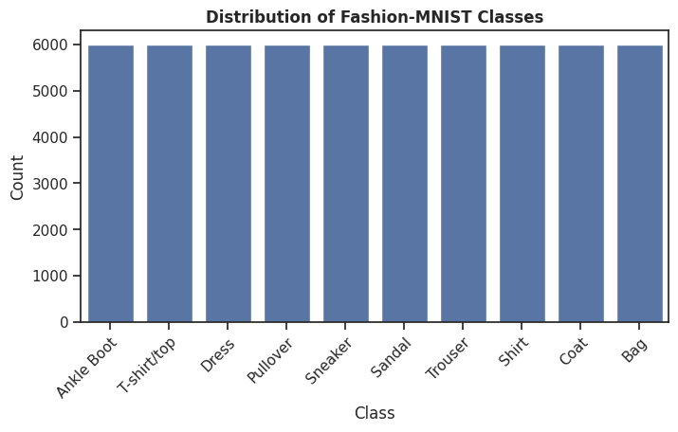
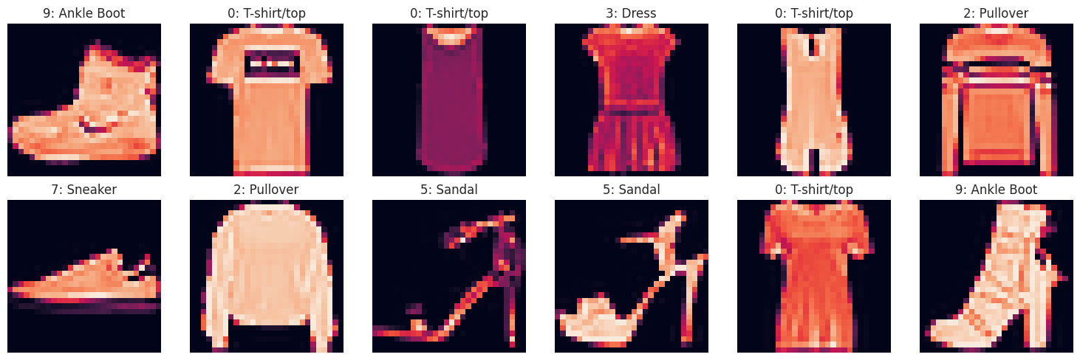
EDA & PRE-PROCESSING
EDA
Check distribution of classes and identify any imbalance to ensure training fairness
Visually inspect images to:
Analyse image quality and patterns
Determine if augmentation is required
Evaluate filter size and if padding is required
Pre-Processing
Apply min-max scaling
Reshape arrays to fit CNN input dimensions
Ensure grayscale images have a single channel

Slide 6
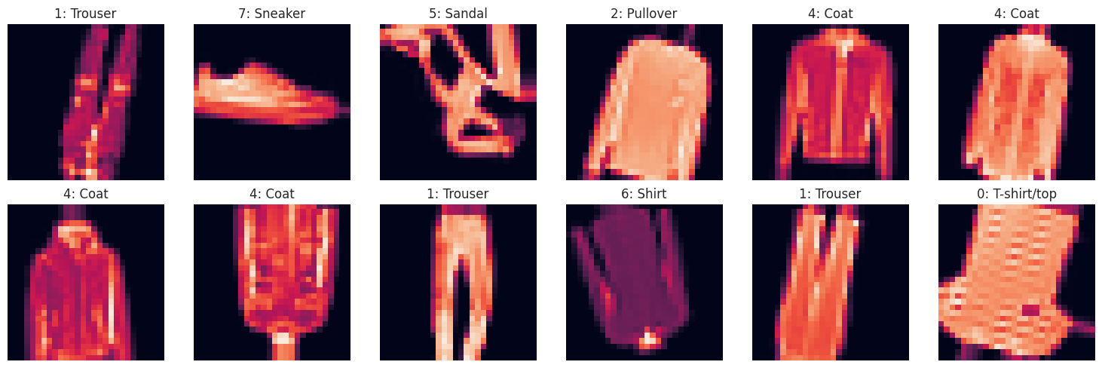
DATA AUGMENTATION
Purpose
Artificially inflate training dataset size by transforming images to create new datapoints
Improve model performance by training on a greater variety of images, increasing generalisation ability
Prevents overfitting by reducing model’s reliance on specific patterns (e.g., image being positioned upright all the time)
Transformations Applied
Random rotation (±20°)
Shift width and height (±10%)
Zoom factor (±5%)
Flip horizontally and vertically
Image preserved by filling from nearest pixels, where applicable
Augmentation of original dataset

Slide 7
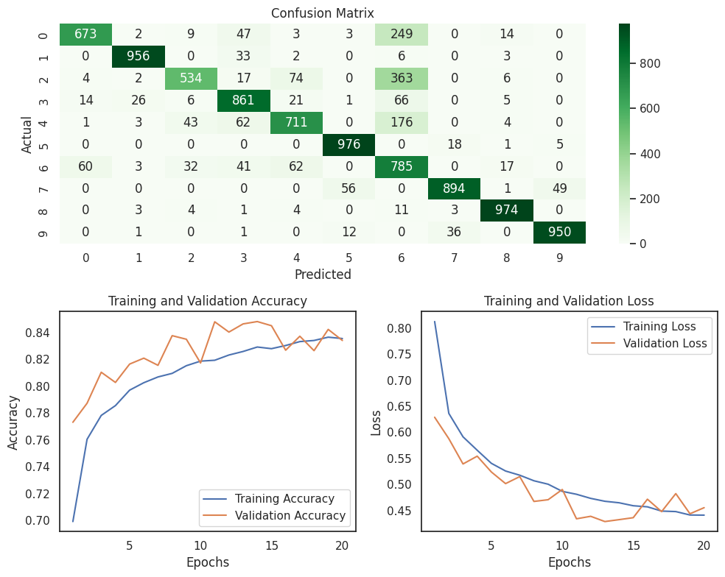
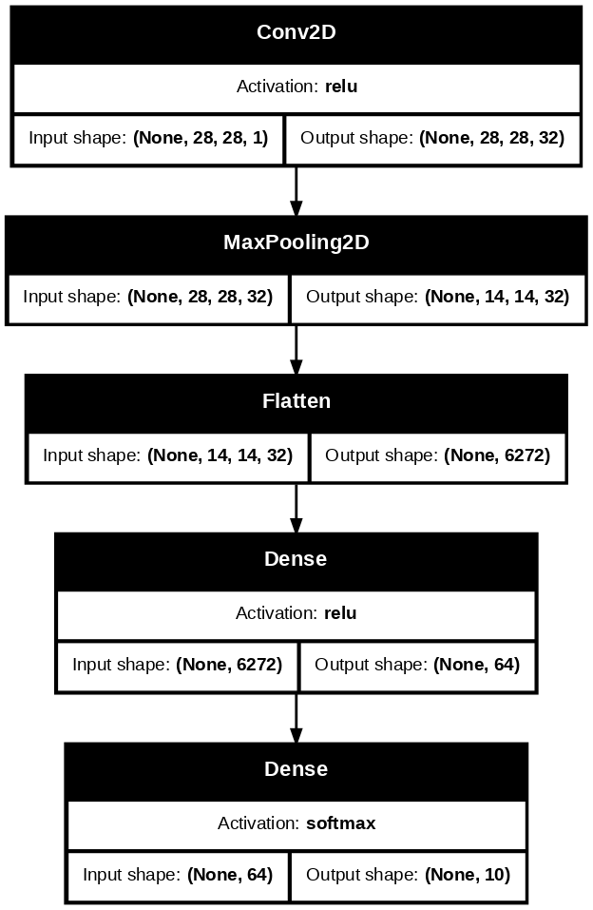
SIMPLE BASELINE MODEL
Architecture & Hyperparameters
Single convolutional layer (32 filters of kernel size 3 x 3)
Two fully-connected layers (one with 64 neurons and last layer with 10 neurons)
ReLU activation
HeNormal initialiser
MaxPooling for dimension reduction
Performance
Test accuracy: 83.1%
Baseline performance to beat in further model iterations

Slide 8
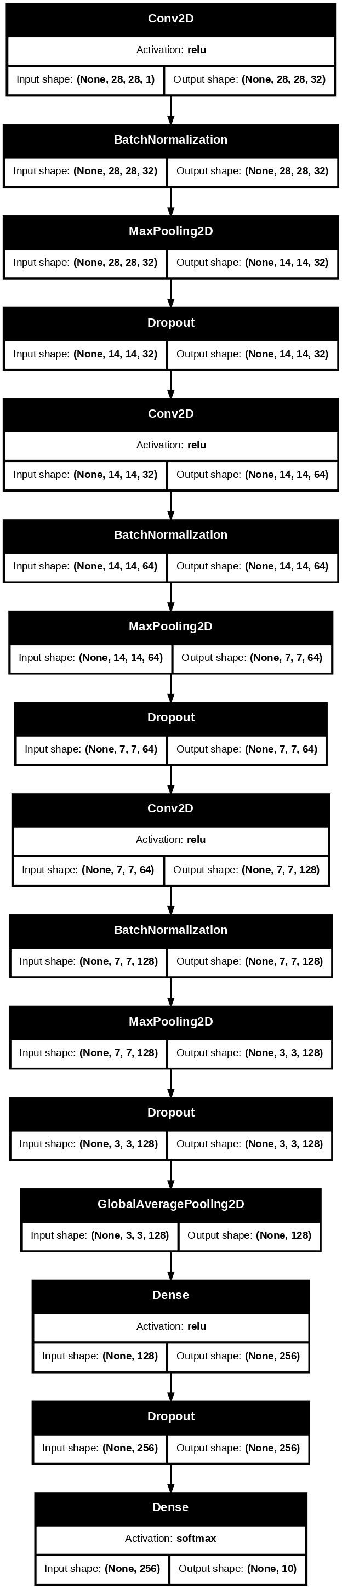
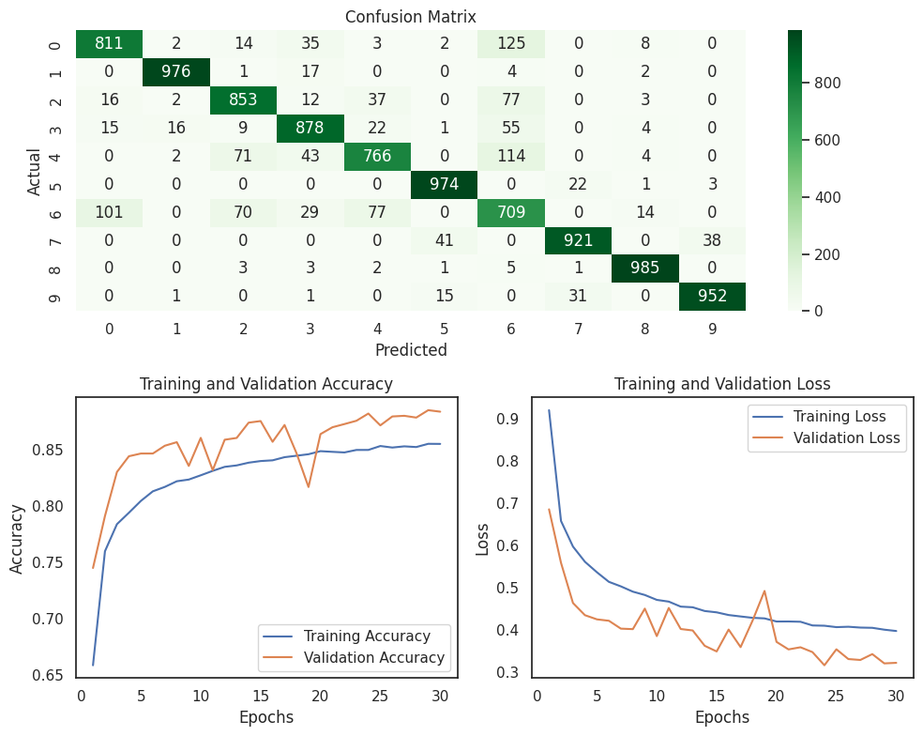
MODEL v1
Architecture & Hyperparameters
Four convolutional layers (32, 64, 128, and 256 filters of size 3 x 3)
Two fully-connected layers (one with 256 neurons and last layer with 10 neurons)
ReLU activation
HeNormal initialiser
MaxPooling for dimension reduction
Added batch normalization and dropout (0.2)
Performance
Test accuracy: 88.2%
No observable overfitting gap based on training and validation accuracies

Slide 9
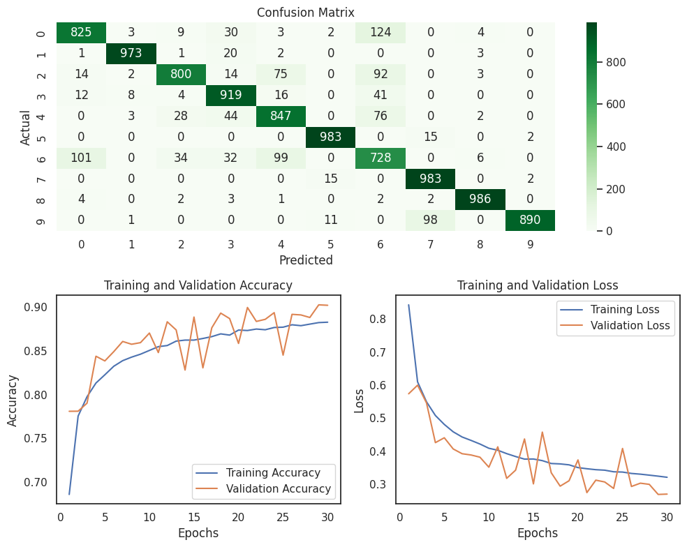
MODEL v2
Architecture & Hyperparameters
Same overall architecture as v1
Four convolutional layers (32, 64, 128, and 256 filters of size 3 x 3)
Two fully-connected layers (one with 512 neurons and last layer with 10 neurons)
ReLU activation
HeNormal initialiser
MaxPooling for dimension reduction
Dropout reduced from 0.2 to 0.1
Performance
Test accuracy: 89.3%
Model improved after reducing dropout to improve training process and by increasing number of dense layer neurons

Slide 10

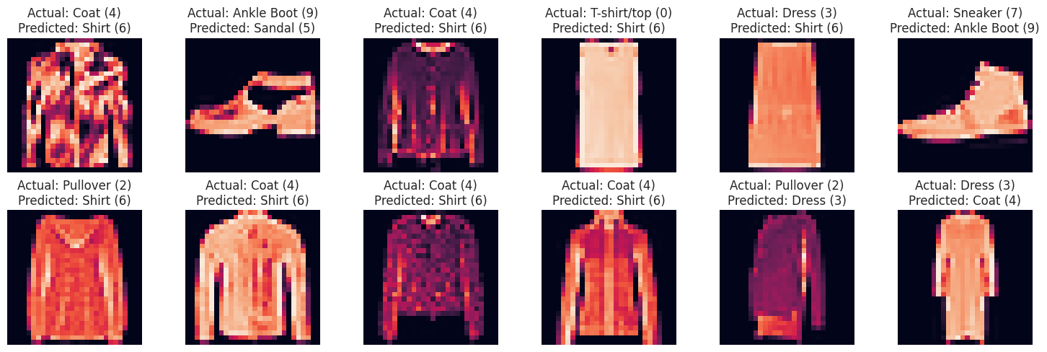
FINAL MODEL
Using model v2 for tuning:
Hyperparameters Tuned
Learning rate (0.001)
Batch size (64)
The above two parameters were tuned to enhance convergence speed and improve the model’s generalization capability.
Final Model Performance
Test accuracy: 88.2% (a 1% decrease from v2)
Based on sklearn classification report:
Precision: 90%
Recall: 88%
F1-score: 88%
Misclassifications primarily across shirts (class 6), T-shirts/tops (class 0), pullovers (class 2), dresses (class 3), sneakers (class 7), and ankle boots (class 9)

Slide 11
FUTURE IMPROVEMENTS
01
03
DATA AUGMENTATION
HYPERPARAMETER TUNING
Improve data augmentation strategy by targeting images from under-performing classes (e.g., Class 6: Shirts)
Experiment with more hyperparameters to increase accuracy and model performance
02
04
NETWORK ARCHITECTURE
EXPERIMENTATION APPROACH
Increase number of layers/filters to capture more complex patterns (e.g., long-sleeved shirts)
Determine optimal number of layers for prediction and computing efficiency
Be more targeted in adjusting architecture and hyperparameters
Establish modelling framework to systematically develop and evaluate models

